Slide 1
People’s Lives Changed by God.

Slide 2
“When I got to your site and saw the list of articles, it freaked me out. Every single question I had, it was all right there. I read through the whole site.
I read about how to become a Christian. So I just prayed, Yeah, what it says on the screen, God, I want that, I want to know You.”

Slide 3
“I can’t say how much this site has helped me. I have been looking for about half an hour. This is my first time on the site. My eyes are being opened to so much I can hardly contain it.”

Slide 4
A student wrote in her blog
“…the funniest thing happened when I read the first paragraph of the article…I wanted to read the next…and when I did…I wanted to read the next, and the next.
(you should all look at this article: http://www.everystudent.com/features/isthere.html )
Something made me want to believe again. I mean Believe.
Just reading the intro to the article gave me a new-found respect for Christian Thought. I’d been looking for a reason not to be disgusted by Christians I didn’t know.
I’ve taken another step closer. I read that article, and I saw God coming to me from a place outside myself, that is, revealing Himself to me from the actions of others. The faith I had that He existed was suddenly renewed.”

Slide 5
“I have just asked Jesus Christ to forgive me and save me from hell. I believe he has. Thank you for telling me about Gods love, I really never felt loved by God until now.”

Slide 6
"Your site just proved God's existence and I prayed the prayer and this time it all fit together and this empty feeling that I had inside of me is gone. It is so amazing. Thank you."

Slide 7
“I visited your site last year and it has been a life-changing experience. I came to know about the love of God and the relationship we can have with him. I do not have words to explain the joy I am experiencing today and I think my life would have been different if I had not visited everystudent.com on that wonderful day.” ~ John

Slide 8
“For years God has been trying really hard to get a hold of me through people I’ve met, but it just never sank in. Then a few weeks ago something made me google ‘how to become a christian’ and I got your site, and I have not looked back since!”

Slide 9
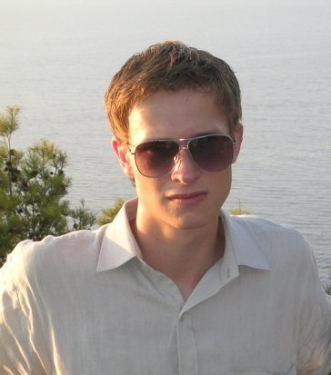
Ondrej – Czech Republic
“My prayers are now very emotional. Often tears flow on my cheeks. It is impossible to describe what I have had in the past 14 days. I found a light in the dark…

Slide 10
…I opened my heart to the Lord Jesus, and I put my life in God's hands. I made a wooden cross as a pendant and wear it on a leather cord, to think more about Jesus and to be closer to Him. I am so happy.”

